Slide 1
Car Accident Severity Code
<submission, week 3>
Yonghoon, Park

Slide 2
Index
I. Introduction ---------------------------------------------------------------------------------------- 4
1. A description of the problem ------------------------------------------------------------------ 4
1-1. Background ------------------------------------------------------------------------------------ 4
1-2. Problem Description -------------------------------------------------------------------------- 5
II. Data ------------------------------------------------------------------------------------------------- 6
III. Methods -------------------------------------------------------------------------------------------- 9
3-1. Data pre-processing ---------------------------------------------------------------------------- 9
3-2. Severity code -----------------------------------------------------------------------------------10
3-3. Address type ------------------------------------------------------------------------------------11
3-4. Weather -----------------------------------------------------------------------------------------12
3-5. Road condition ---------------------------------------------------------------------------------13
3-6. Feature selection : x and y data --------------------------------------------------------------14
3-7. Normalize data ---------------------------------------------------------------------------------15
IV. Conclusion ----------------------------------------------------------------------------------------16

Slide 3
Index of picture
<Picture 2-1> ------------------------------------------------------------------------------------------ 6
<Picture 2-2> ------------------------------------------------------------------------------------------ 7
<Picture 2-3> ------------------------------------------------------------------------------------------ 8
<Picture 3-1> ------------------------------------------------------------------------------------------ 9
<Picture 3-2> ------------------------------------------------------------------------------------------10
<Picture 3-3> ------------------------------------------------------------------------------------------11
<Picture 3-4> ------------------------------------------------------------------------------------------12
<Picture 3-5> ------------------------------------------------------------------------------------------13
<Picture 3-6> ------------------------------------------------------------------------------------------14
<Picture 3-7> ------------------------------------------------------------------------------------------15

Slide 4
I. Introduction
1. A description of the problem
1-1. Background
since the invention of the automobile road and highways become one of the largest life takers as mortality rates are higher than ever in the past 10 years. Each year around 20-30 million people get into a road accident. In which around 10% of those lose their lives. Road accidents are a serious shame for our society and still we are not in a state to reduce it. Most of the innocent casualties are of the pedestrians, cyclists and the bikers and between the age of 20-35 years, the future of any country and the solo earners of a family. Naturally, a question to be asked is what is the cause of such high percentage of car accident.

Slide 5
1-2. Problem Description
We have to gather old accident record and its severity for place with other information like location of accident, number of people involved, number of pedestrians, number of vehicles time and date of accident, way of accident, road condition, lighting and weather at place of accident and create a machine learning model with this data so that lots if we pass the following details, the model can predict the severity to us.
Predicting the data will help us to get cautious in advance and then it will be the person's choice to whether they should proceed on the same road with precaution or do a detour to a safer road.
In this project we will try to predict injury collision and Property Damage Only collision, this report are aim to stakeholders interested preventing and reducing injury collisions and Property Damage Only collision.

Slide 6
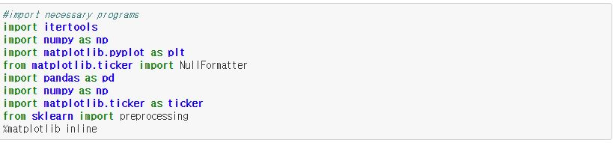
II. Data
The data that will be used in the model building will be the collision data from Seattle. It includes all collisions provided by SPD and recorded by traffic records. The data has been recorded from 2004 until present, updated weekly. Below shows the first five rows of the data table.
<Picture 2-1. header(code)>

Slide 7
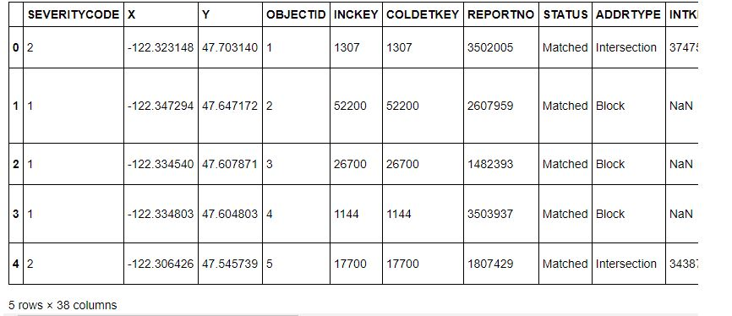
<Picture 2-2. Severity code>
There are 37 attributes in the data. Among them, severity code (SEVERITYCODE), which categorizes the severity of the accident from 0 (unknown) to 3 (fatal), will be our target value. As for attributes that will be used to predict the target value, collision address type (ADDRTYPE), weather condition (WEATHER) and road condition (ROADCOND) will be used.

Slide 8
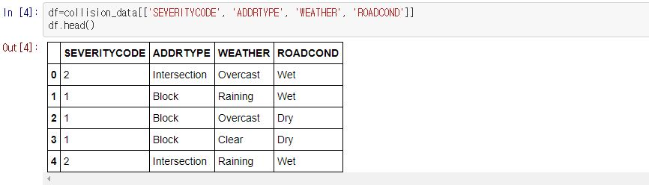
<Picture 2-3. Collision relationship(code)>
shows the table with only the target and attributes stated above.

Slide 9
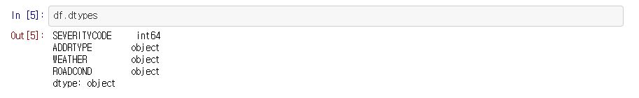
III. Methods
3-1. Data pre-processing
This section will pre-process the data before model building. Each attributes and target will be processed. The data type is shown below.
<Picture 3-1. Data pre-processing>

Slide 10
3-2. Severity code
The unique values of the data are shown below.
<Picture 3-2. Severity code>
The severity code target has values of 1 and 2. From the metadata, 1 indicates property damage and 2 indicates injury.

Slide 11
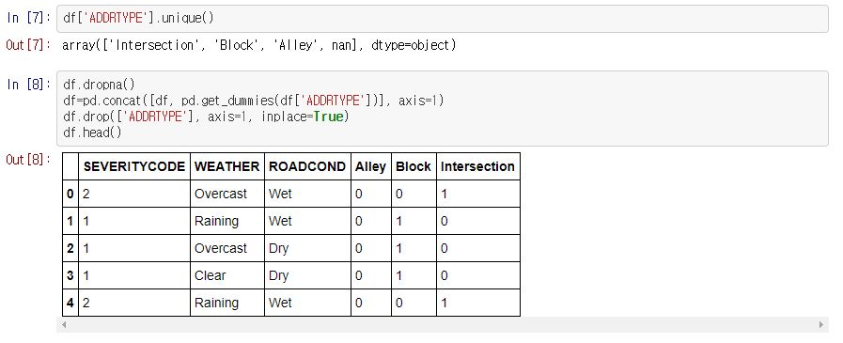
3-3. Address type
Remove non values, convert categorical variables into quantitative variables.
<Picture 3-3. Address type>

Slide 12
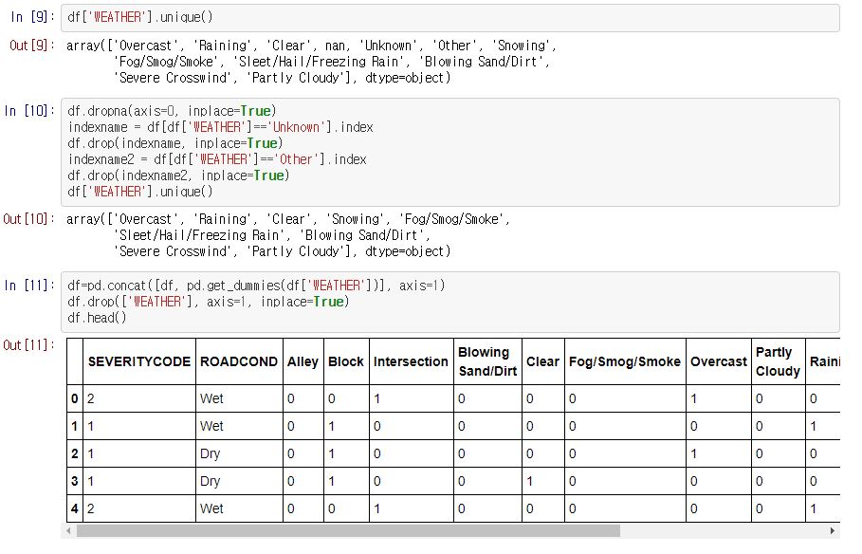
3-4. Weather
Remove non values, convert categorical variables into quantitative variables.
<Picture 3-4. Weather>

Slide 13
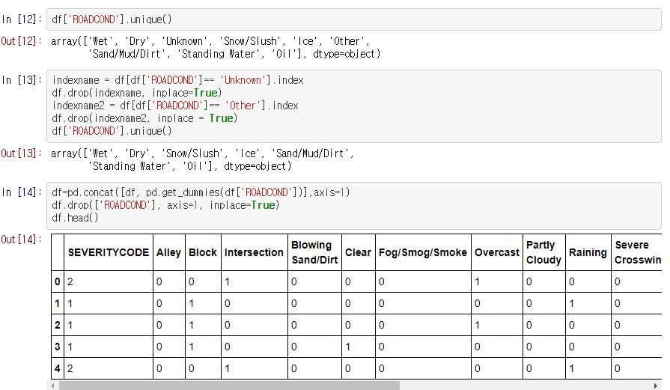
3-5. Road condition
Remove non values, convert categorical variables into quantitative variables.
<Picture 3-5. Road condition>

Slide 14
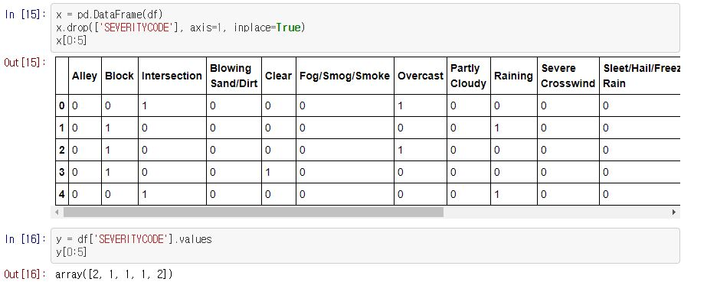
3-6. Feature selection : x and y data
Set the attribute data(feature data) as X, and set the target data(severity code) as y.
<Picture 3-6. Feature selection x and y data>

Slide 15
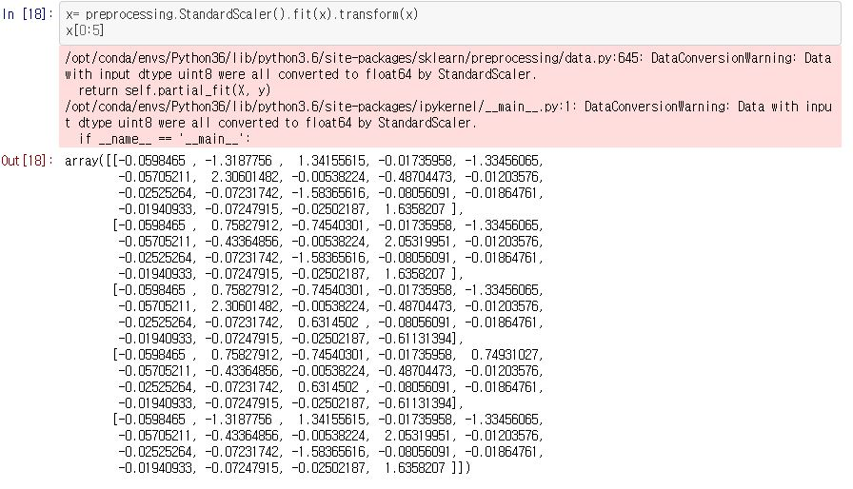
3-7. Normalize data
Collecting Normal data are shown below.
<Picture 3-7. Normalize data>

Slide 16
IV. Conclusion
This report, show that method to prevent car accidents. Firstly, the climate and road conditions have lots of influence on car accident. Secondly, making up the dependent and independent variables, the purpose of collecting the data, dependent variables such as car accidents and independent variables such as climate and road conditions were set and so on. Third, we have established a range of coordinates to implement the methodology through big data.
As a result, it is recognized that the cause of car accidents are highly correlated with climate and road conditions. This requires a matrix of accurate statistical data on climate and data on road conditions in each region. In the future, it will be implemented as a system that can reduce car accidents by presenting results through raw data and preannouncement through machining learning.

